Slide 1
Wikipedia and youtube as a new source of information
Matěj Trakal and Tomáš Bouda
Notes:
Hello, we want to welcome you on our presentation.
My name is Matěj Trakal and this is my colleague Tomáš Bouda.
We prepared a presentation about new information sources.

Slide 2
Timeline
Introducing
History of information sources
Wikipedia and youtube
About wikipedia and youtube
History
Trends
Evolution
Test of information sources
Summary
Questions time
Notes:
So, when you will have some questions please remember or better forget it. At the end of presentation will be a question time.
In first part we say something about history of information sources.
In main part we try describe and compare wikipedia and youtube and say a little bit of their history.
So let’s start

Slide 3
Before wikis and youtube
Libraries – books, magazines, newspapers
TV and radio
“Closed“ servers (scientific, news servers)
Phenomenon of web 2.0
wikis, youtube
sharing personal information
Notes:
In history was no computers and information was wrote into many books, magazines and another printed materials.
After “book time” arrive TV and radio time. Part of information is moved and printer materials go slowly down, but still are main source of prime information.
With internet expansion are created closed information portals, mostly of technical character. This portals are managed by fanatics and people which are interested in actual problem. This guarantee that published information has high-quality same as in books.
After closed servers comes open solutions as wikipedia servers. With this start information sharing. Everybody can contribute on contents, but can add good or trash information and here start one big problem. Quality of information.
Today is only I hope minority group people which want add trashed information and this information are repaired by others contributors.

Slide 4
About wikipedia and youtube
Wikipedia
biggest global open encyclopedia
More than 2 800 000 articles in English wiki
259 languages mutations
Youtube
biggest video server on internet
22 languages mutations
Regional restrictions
Notes:
We speak about wikipedia, but what is it? Wikipedia is one of the biggest global open encyclopedia. What we mean a word open? We mean that everyone can contribute with his knowledge and improve provided services.
This encyclopedia has more than 2 800 000 articles in English version of wikipedia and 120 000 in Czech version and is accessible in more than 250 languages!
On second side we have there a closed video server youtube. It is the biggest video server on the internet. It has same problem as wikipedia – than can contribute everybody. Because record video is faster than write articles this server took this server teenagers and theirs feeling effusions. This server unlike wikipedia is today fully trash. Information cost is really low, but sometimes are there some interesting or funny videos.
Server is actually translated into 22 languages but only web pages and not contents.
This server is disreputable by its regional restrictions. It mean, that some contents is not accessible in others countries or in country for which is determinate. For example in our country you can’t play some clips by vypsaná fixa.

Slide 5
History
 | Wikipedia | Youtube
Founded | 15th January 2001 | February 2005
Year | Wikipedia [articles]
End 2001 | About 1000
2003 | 100 000
2005 | 750 000
2008 | 2 500 000
March 09 | 2 800 000
In February 2006 was Youtube bought by Google Inc. for $1,65 billions
Notes:
A little bit about history:
Wikipedia was founded in January 2001 and youtube four years after.
Wikipedia has get year by year more and more articles into its database.
About youtube we don’t found any information for count of videos but we know that youtube was bough by Google in February 2006.

Slide 6
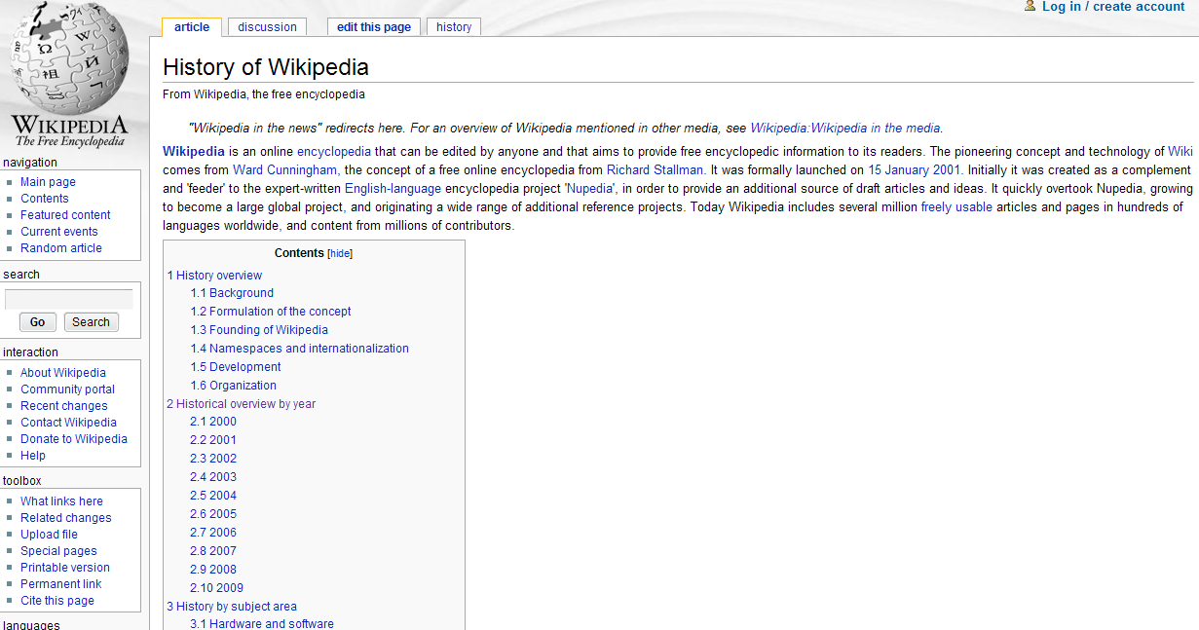
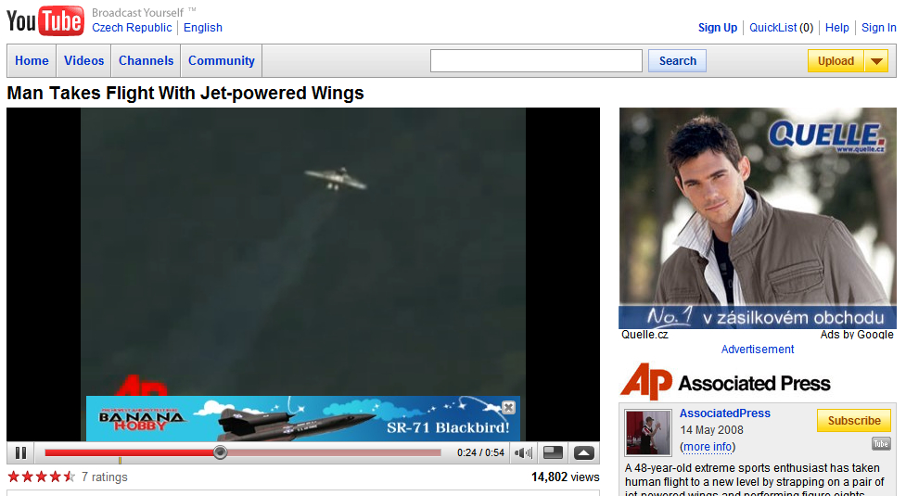
Financing
Wikipedia
Youtube
Non-commercial
Sponsored by users
Commercial
Financing from advertisements
Notes:
Financing:
Wikipedia is non-commercial. It means, that there is no ads.
Youtube is commercial. There are some advertisement which pay load for working this server.

Slide 7
Trend of Czech wikipedia articles
Notes:
There you can see trend of Czech wikipedia articles.
With every year are there more and more articles.

Slide 8
Future development
Wikipedia
improving of quality and quantity information and merging with other services
Youtube
separating in to commercial and non-commercial sphere
improving video quality
Notes:
Into the future we think that wikipedia will improve a quality of supported information and join with other servers with images or videos.
We think that youtube will be separated to commercial for example music video clips, politic conferences and non-commercial sphere where will be published personal video blogs and another personal videos.

Slide 9
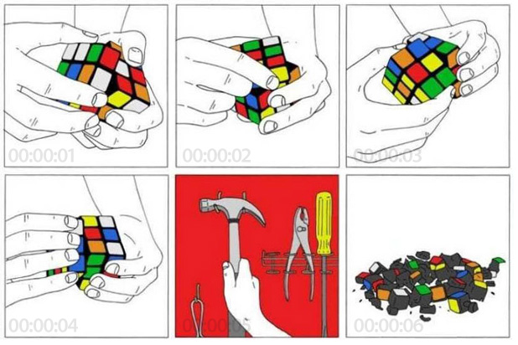
Methods of testing
Quality and quantity
Speed to find information
Form
Notes:
We test this servers for try to find required information.
Why is there a rubic cube on the picture?
Because we try to find information about it. How to build id, technical information, parameters and others.

Slide 10
Quality
 | Wikipedia | Youtube
High quality information | Majority (technical) | Minority (practical)
Trash quality information | Minimum | Mainly all
Quality of Czech information | Very good | Good
Quality of English information | Best | Good
Quantity
 | Wikipedia | Youtube
Quantity of Czech information | Enough | Not much
Quantity of English information | Almost all | Enough
Notes:
Methods of testing was aimed to quality, quantity and speed to found required information.
On wikipedia you can find technical information about rubic cube, but we didn’t found how to build it.
On youtube is how to, but no technical information…
Results you can show in tables behind me.

Slide 11
Speed to find information
 | Wikipedia | Youtube
Technical information | Fast | Slow/impossible
Practical information | Slow/impossible | Medium – many trashes
Links:
Wikipedia
Youtube
Bubble sort algorithm
Notes:
Sometimes is better see one video than study from texts.
On the picture is shown bubble sort algorithm. This animations is from wikipedia, but it’s not so much good for understanding.
When you try to find on youtube there are many better video tutorials.

Slide 12
Form of information
Wikipedia
Youtube
Mainly text information
Some pictures
Minimum animations
Understandable information
+ for technical information
- not much practical information
Mainly video-tutorials
Some pictures (in video)
Minimum texts
Understandable information
+ for practical information
- none technical information
Notes:
On this slide you can compare form of published information.
How you can look wikipedia contains mainly text and some pictures. Sometimes is there animation, but not so much often.
On youtube are mainly videos and some pictures, but included in videos.

Slide 13
Summary
Wikipedia
Biggest online encyclopedia
Non-commercial
Technical information
Faster for find information
Youtube
Biggest video server
Commercial
Practical information
Many trashes

Slide 14
Sources
Curiously wikipedia ☺
http://en.wikipedia.org/wiki/History_of_Wikipedia
http://meta.wikimedia.org/wiki/List_of_Wikipedias
http://en.wikipedia.org/wiki/YouTube
http://cs.wikipedia.org/wiki/%C4%8Cesk%C3%A1_Wikipedie
and some others…
From this link you can download this presentation: http://fei.trtkal.net/materialy_public/4.%20semestr/%5b2008-2009%5d%20IPA4I%20-%20Hlouskova/

Slide 15
Questions time
Thank You for visiting this presentation

